Slide 1
Requirements Traceability
Navjit Singh, Mason Graves, Ramzi Kassim

Slide 2
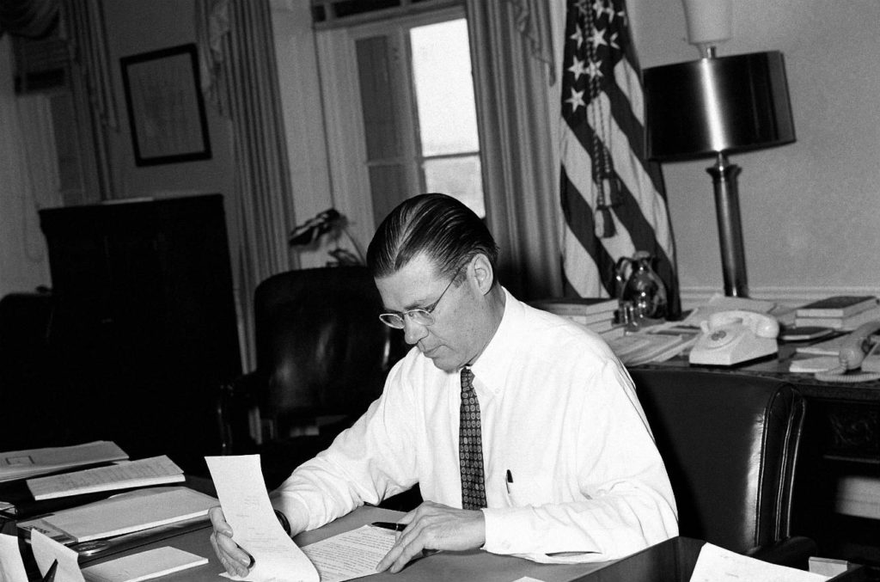
“Management is the gate through which social and economic and political change, indeed change in every direction, is diffused through society.”
Robert McNamara
Secretary McNamara helped implement systems analysis in the US government.

Slide 3
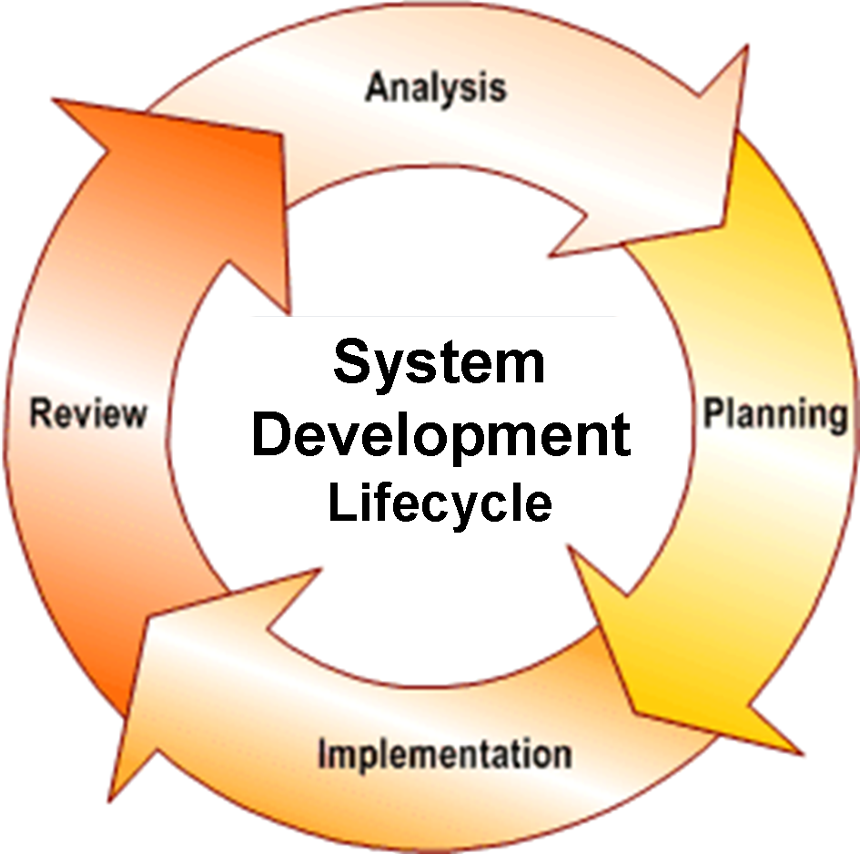
Introduction
Requirements traceability is a useful part of understanding systems requirements.
The ability to visually see the development of a requirement through a product’s life cycle.
Identification of the goals of stakeholders through documentation in a meta-model or matrix.
Utilization of layers of information or artifacts to decompose high-level requirements into digestible, development-ready requirements.
To see how a requirement evolves from its origin to completion.
Traceability allows for further refinement and through multiple phases of development

Slide 4
Benefits
The development life cycle as a result of modeling traceability has some benefits:
Improvement of software development by tracing the history of issues through a life cycle.
Greater efficiency of development time and improved results in product life cycles.
Recycling of product components to be utilized with others.
Greater optimization of products through testing and moving through multiple phase development.
Ability to track completion of a product through Project status analysis and other reporting tools.

Slide 5
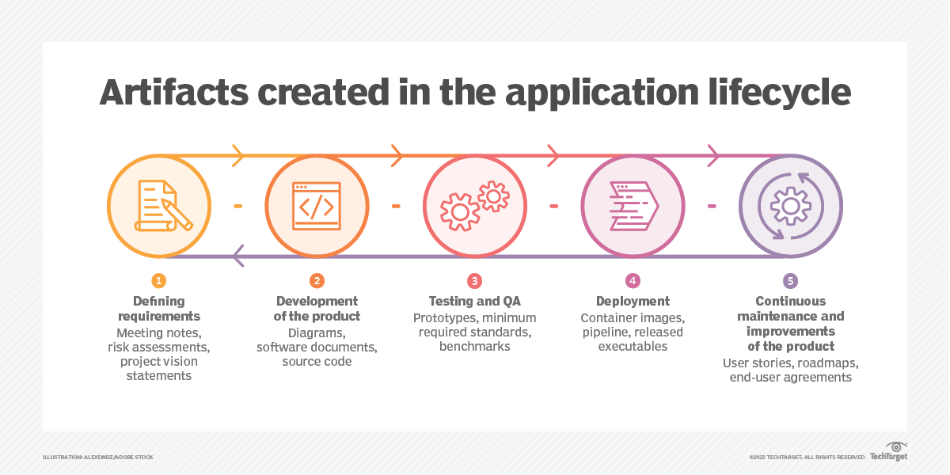
Artifacts
Item that describes design, function, and architecture of a software
Roadmap that helps developers and stakeholders trace the software development process
Many forms of Artifacts include:
Business Process Model
Use Case Diagram
Use Case
Requirements
Prototype
Etc.
Lack of artifacts may cause Big problems for developers in the future
(don’t understand how the software works)

Slide 6
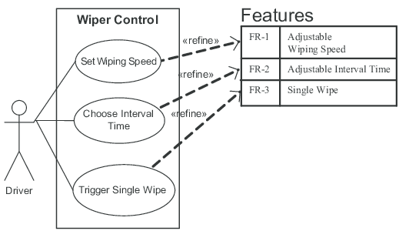
Links
Show relationship between a source and a target artifact
Used to demonstrate how several elements are connected
Used Frequently in diagrams and matrices
Helps layer information
Shows sequencing of information from origin to completion.
Helps flesh out the fulfillment of requirements into manageable associations of smaller artifacts from one to another.
Notes:
Is use case effort estimation objective or subjective? It’s objective
Is user story points objective or subjective? more subjective
Which is more objective use case effort or user story points? User Story Points
Natural language is not the best because of ambiguity, structured language.
Where are the requirements found in scrum/ agile. → Backlog
What methodology is common to open source? → agile/scrum,
Reporting Tools slide will be asked on exam!!!

Slide 7
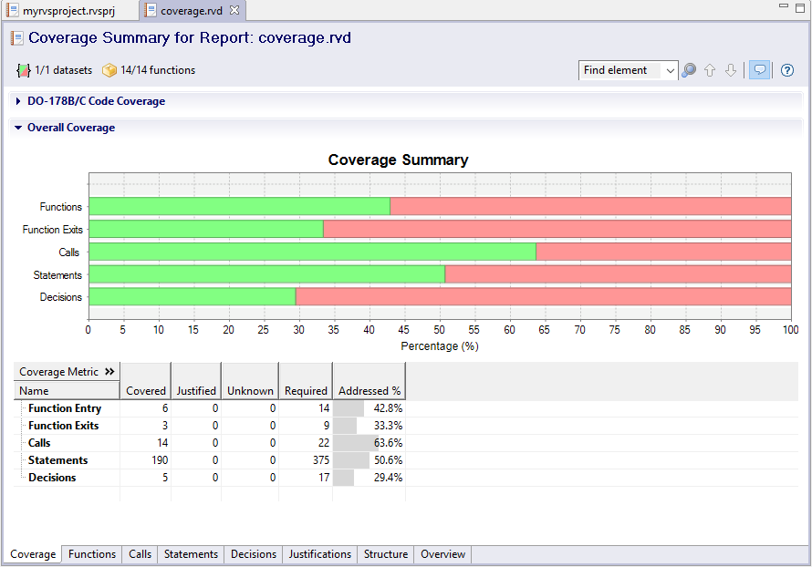
Reporting Tools in Projects Used for Traceability
Coverage Analysis: A detailed report that makes sure all requirements are or are not met.
Project Status Analysis: Tracking the completion state of the project based on the meeting of requirements based on if they are linked or have incomplete trace links shows that the status of the project if it is still in progress. Links between artifacts are important for completing requirements.
Change Impact Analysis: Reporting of the verification and validation of artifact trace links. This will result in confirming that all artifacts are correctly linked and if any requirement changes are made they will be correctly readjusted.
Notes:
Is use case effort estimation objective or subjective? It’s objective
Is user story points objective or subjective? more subjective
Which is more objective use case effort or user story points? User Story Points
Natural language is not the best because of ambiguity, structured language.
Where are the requirements found in scrum/ agile. → Backlog
What methodology is common to open source? → agile/scrum,
Reporting Tools slide will be asked on exam!!!

Slide 8
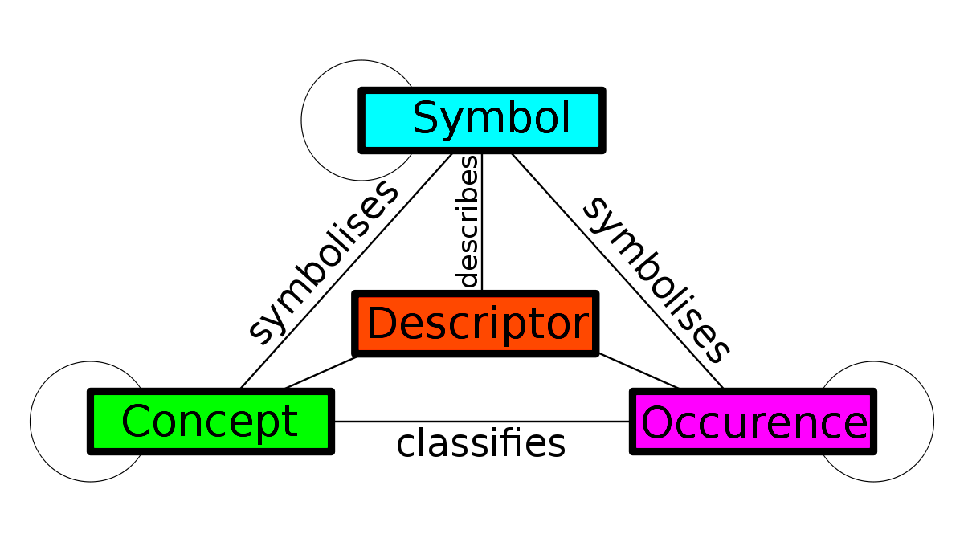
Meta-modeling
Simply put, a meta-model is a model of a model
What separates a model from a meta-model is that a meta-model defines structure
There are no specifics or semantics
Think of a meta-model as a template
By complying to the structure of a meta-model, a model will become an “Instance” of that meta-model
Notes:
What i want you to take from this image is the idea that meta-models are templates or instructions on how to the company or firm plans to make specific models in the future
Without them, it would be very difficult for the company to keep consistent models

Slide 9
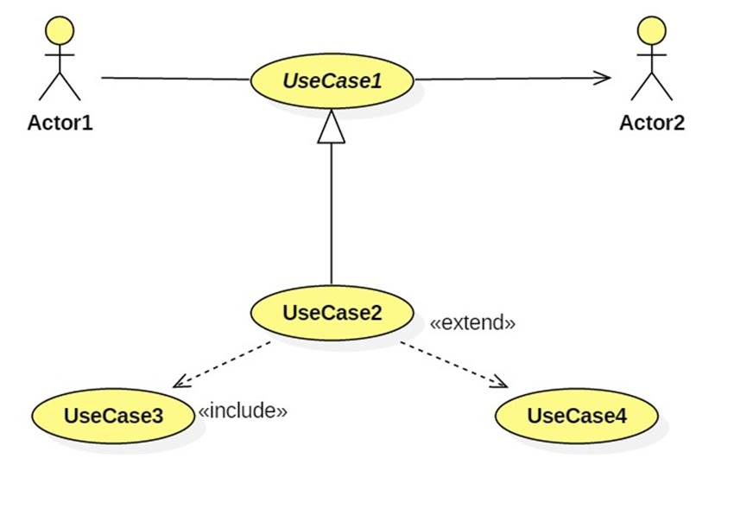
Meta-modeling continued
A great example of meta-modeling is Use Case
"the specification of a set of actions performed by a system, which yields an observable result that is, typically, of value for one or more actors or other stakeholders of the system"
Benefits of meta-modeling include:
User Ease
Define the scope of desired system
Easy to Implement
Standardization

Slide 10
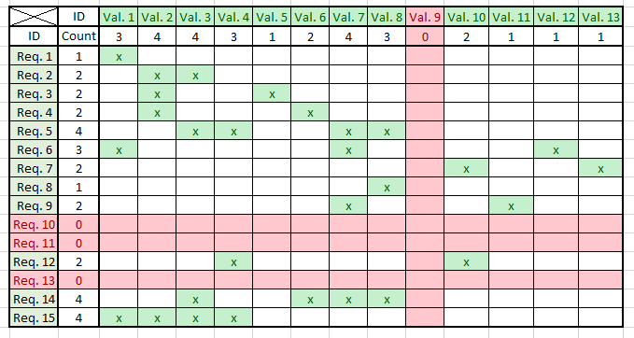
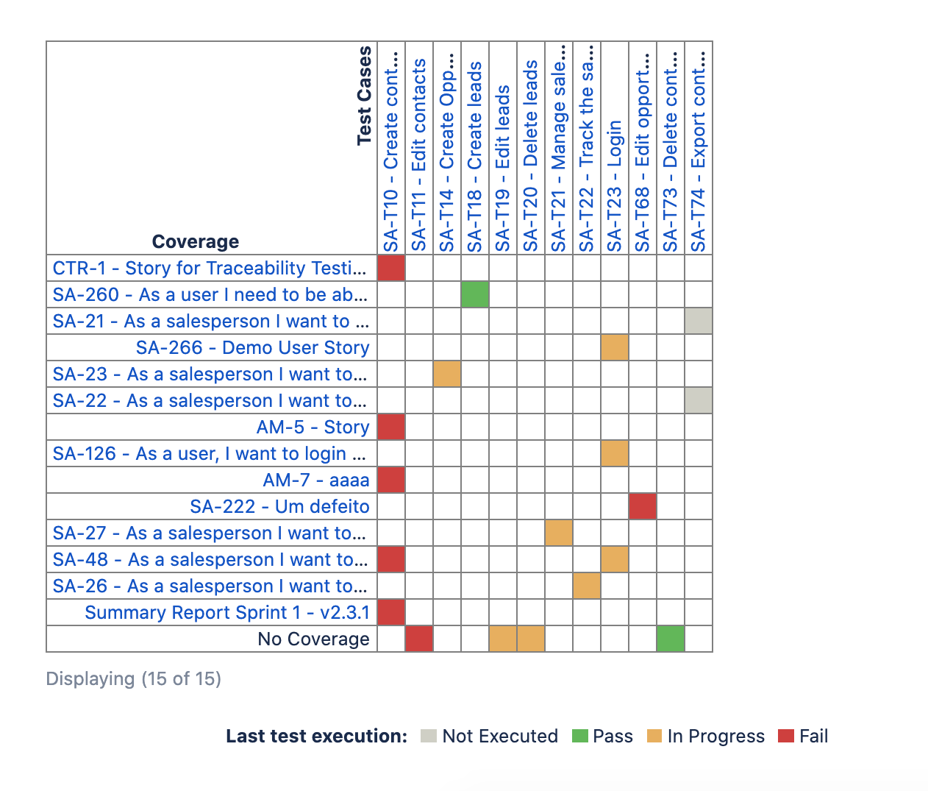
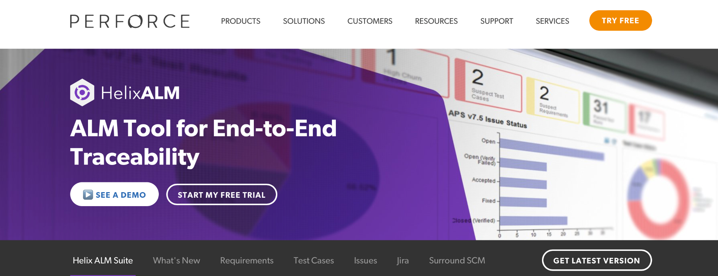
Tools used to create Traceability Matrices
Excel: A spreadsheet program that is used for analyzing and organizing data.
Jira: An application used by PM that plans, assigns , manages and reports software releases.
Helix ALM: A software that allows developers to manage issues, testing, and requirements

Slide 11

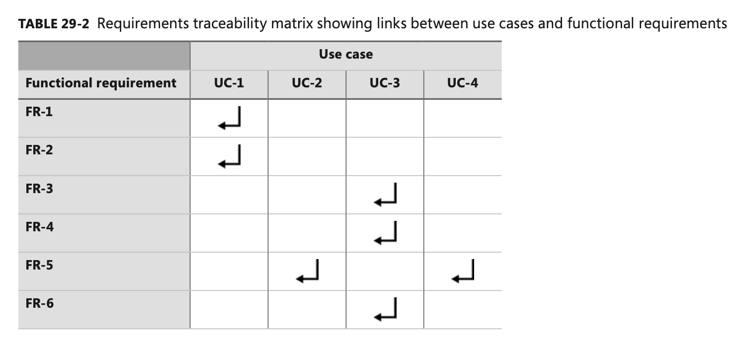
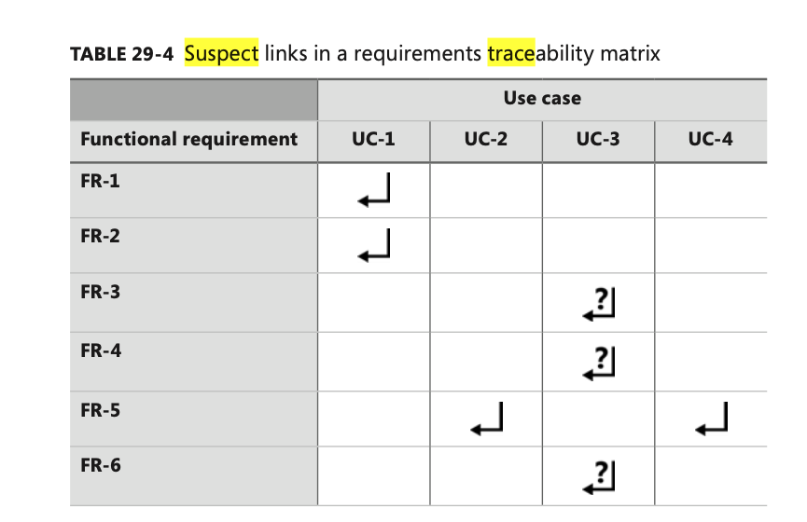
Suspects in a Traceability Matrix
When a functional requirement has been changed, all of the links associated with the requirement are now known as “suspects”.
All of those suspects will be marked on the traceability matrix.
Review the impact this change will have on the project.
Linked Artifacts are NOT related after the change.

Slide 12
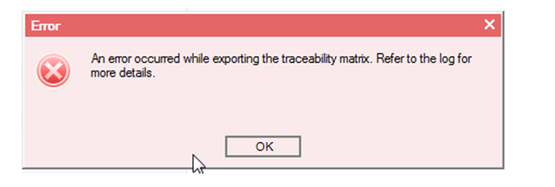
Using Traceability to Find Software Bugs
Projects with complete traceability are less likely to have failures compared to those that do not.
Using traceability will allow one to view what has been added and deleted from a project.
While troubleshooting, one can looks towards the traceability matrix to review the suspects and determine if a change led up to a bug.

Slide 13
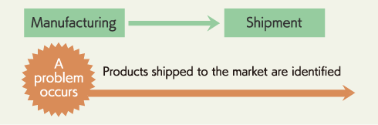
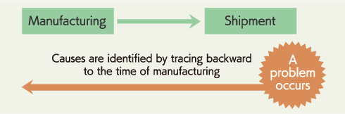
Types of Traceability Matrices
Forward Traceability: Determines if the project is headed towards the right direction.
Backwards Traceability: An action used to track records backwards in the timeline
Bi-directional Traceability: The ability to trace forwards and backwards.

Slide 14
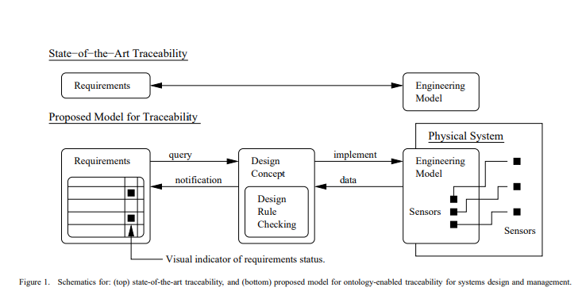
Implementation of Semantic Infrastructure Using Traceability
Semantic infrastructure integrates descriptive solutions and written relations between artifacts with software.
Recently, methodologists have come up with algorithms and software using traceability to verify systems requirements with a traceability approach to build complex products.
Models for complex products are turned into traceability diagrams while researchers use these to help create design solutions for sophisticated products.
Creating a system for “rule checking,” researchers hope to help automate and streamline software to recognize traceability and help fulfill systems requirements.
These methodologists also wish to reuse the semantic infrastructure among different applications to find issues with system functionalities or performance.

Slide 15
Conclusion
A RTM is a document that traces user requirements with test cases.
Requirement Traceability ensures that a project doesn’t neglect any steps while guaranteeing that the final project meets customer needs.
Suspects indicate that linked artifacts needs to be updated.
Using traceability improves the product life cycle because the percentage of failure decreases significantly when implemented.

Slide 16
Sources
Using traceability to find software bugs (http://www.jsoftware.us/vol12/252-JSW15225.pdf)
Implementing semantic software infrastructure FOR reqs traceability (systems analysis creating relationships through diagrams) (https://www.researchgate.net/profile/Mark-Austin-3/publication/265849957_A_Semantic_Platform_Infrastructure_for_Requirements_Traceability_and_System_Assessment/links/541edec90cf241a65a1aa52d/A-Semantic-Platform-Infrastructure-for-Requirements-Traceability-and-System-Assessment.pdf)
Systems and software engineering – Vocabulary. Iso/Iec/IEEE 24765:2010(E). 2010-12-01. pp. 1–418. doi:10.1109/IEEESTD.2010.5733835. ISBN 978-0-7381-6205-8.
IEEE Guide for Developing System Requirements Specifications. 1998 Edition IEEE STD 1233. 1998-12-01. pp. 1–36. doi:10.1109/IEEESTD.1998.88826. ISBN 978-0-7381-1723-2.
http://support.ptc.com/help/integrity_hc/integrity120_hc/en/index.html#page/IntegrityHelp/client_docs_managing_suspect_trace_relationships.html
Levy Siqueira, Fabio & Muniz Silva, Paulo. (2011). An Essential Textual Use Case Meta-model Based on an Analysis of Existing Proposals.. 14th Ibero-American Conference on Software Engineering and 14th Workshop on Requirements Engineering, CIbSE 2011.
A guide on traceability https://www.guru99.com/traceability-matrix.html
NEES grid Requirements Traceability Matrix http://www.neesgrid.org/documents/TR_2003_13_v1.1.pdf
Just Enough Requirements Traceability https://ieeexplore.ieee.org/abstract/document/4020054

